Slide 1



E4S and Frank: A Platform for CI/CD with GPUs
Trilinos Users Group Meeting (TUG’23)
https://trilinos.github.io/trilinos_user-developer_group_meeting_2023.html
10am - 10:30am MT
CSRI, Sandia National Laboratories, Albuquerque, NM
Sameer Shende
Research Professor and Director,
Performance Research Laboratory, OACISS, University of Oregon
President and Director, ParaTools, Inc.
https://e4s.io/talks/E4S_Frank_TUG23.pdf

Slide 2
Challenges
As our software gets more complex, it is getting harder to install and validate HPC tools and libraries correctly in an integrated and interoperable software stack
E4S and Frank – a platform for CI/CD!

Slide 3
Extreme-scale Scientific Software Stack (E4S)

Slide 4
ECP’s holistic approach uses co-design and integration to achieve exascale computing
Performant mission and science applications at scale
Aggressive RD&D project
Mission apps; integrated S/W stack
Deployment to DOE HPC Facilities
Hardware technology advances
Application Development (AD)
Software Technology (ST)
Hardware and Integration (HI)
Develop and enhance the predictive capability of applications critical to DOE
24 applications National security, energy, Earth systems, economic security, materials, data
6 Co-Design Centers Machine learning, graph analytics, mesh refinement, PDE discretization, particles, online data analytics
Deliver expanded and vertically integrated software stack to achieve full potential of exascale computing
71 unique software products spanning programming models and run times, math libraries, data and visualization
Integrated delivery of ECP products on targeted systems at leading DOE HPC facilities
6 US HPC vendors focused on exascale node and system design; application integration and software deployment to Facilities

Slide 5
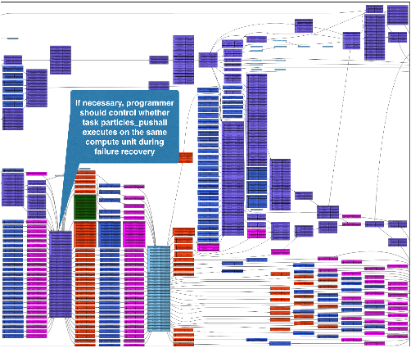
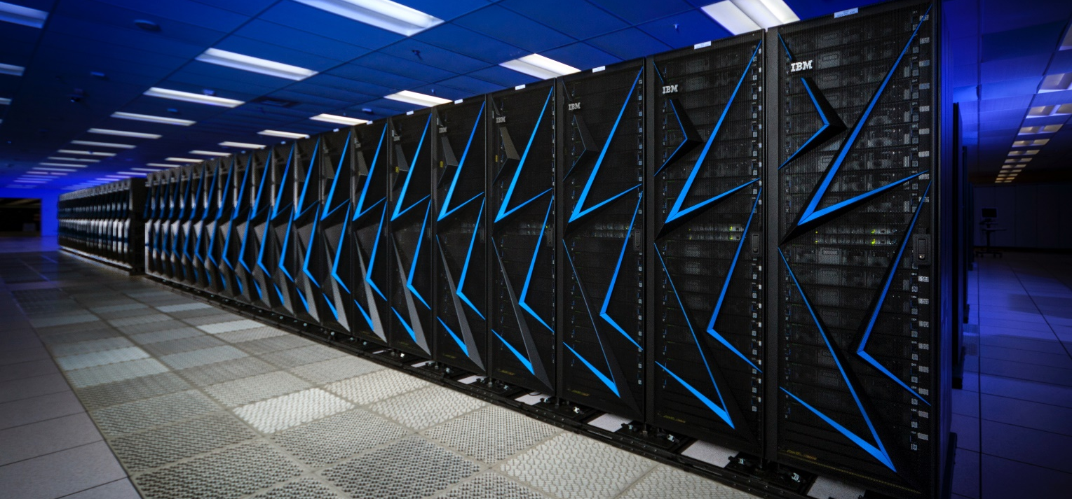
ECP Software Technology (ST)
Goal Build a comprehensive, coherent software stack that enables application developers to productively develop highly parallel applications
that effectively target diverse exascale architectures
Prepare SW stack for scalability with massive on-node parallelism
Extend existing capabilities when possible, develop new when not
Guide, and complement, and integrate with vendor efforts
Develop and deliver high-quality and robust software products

Slide 6


Extreme-scale Scientific Software Stack (E4S)
E4S: HPC Software Ecosystem – a curated software portfolio
A Spack-based distribution of software tested for interoperability and portability to multiple architectures with support for GPUs from NVIDIA, AMD, and Intel in each release
Available from source, containers, cloud, binary caches
Leverages and enhances SDK interoperability thrust
Not a commercial product – an open resource for all
Oct 2018: E4S 0.1 - 24 full, 24 partial release products
Jan 2019: E4S 0.2 - 37 full, 10 partial release products
Nov 2019: E4S 1.0 - 50 full, 5 partial release products
Feb 2020: E4S 1.1 - 61 full release products
Nov 2020: E4S 1.2 (aka, 20.10) - 67 full release products
Feb 2021: E4S 21.02 - 67 full release, 4 partial release
May 2021: E4S 21.05 - 76 full release products
Aug 2021: E4S 21.08 - 88 full release products
Nov 2021: E4S 21.11 - 91 full release products
Feb 2022: E4S 22.02 – 100 full release products
May 2022: E4S 22.05 – 101 full release products
August 2022: E4S 22.08 – 102 full release products
November 2022: E4S 22.11 – 103 full release products
February 2023: E4S 23.02 – 106 full release products
May 2023: E4S 23.05 – 109 full release products
Aug 2023: E4S 23.08 – 115 full release products
https://e4s.io
Also include other products .e.g.,
AI: PyTorch, TensorFlow (CUDA, ROCm)
Co-Design: AMReX, Cabana, MFEM
EDA: Xyce

Slide 7
E4S: Extreme-scale Scientific Software Stack
E4S is a community effort to provide open-source software packages for developing, deploying and running scientific applications on HPC platforms.
E4S has built a comprehensive, coherent software stack that enables application developers to productively develop highly parallel applications that effectively target diverse exascale architectures.
E4S provides a curated, Spack based software distribution of 100+ HPC, 50+ EDA (e.g., Xyce), and AI/ML packages (e.g., TensorFlow, PyTorch).
With E4S Spack binary build caches, E4S supports both bare-metal and containerized deployment for GPU based platforms.
X86_64, ppc64le (IBM Power 9), aarch64 (ARM64) with support for GPUs from NVIDIA, AMD, and Intel
HPC and AI/ML packages are optimized for GPUs and CPUs.
Container images on DockerHub and E4S website of pre-built binaries of ECP ST products.
Base images and full featured containers (with GPU support).
Commercial support for E4S through ParaTools, Inc. for installation, maintaining an issue tracker, and ECP AD engagement.
https://dashboard.e4s.io https://e4s.io/talks/E4S_Support_Sep23.pdf
e4s-cl container launch tool allows binary distribution of applications by substituting MPI in the containerized app with the system MPI. e4s-alc is a tool to create custom container images from base images
Quarterly releases: E4S 23.08 released on August 31, 2023: https://e4s.io/talks/E4S_23.08.pdf
E4S for commercial cloud platforms: AWS image supports MPI implementations and containers with remote desktop (DCV).
Intel MPI, NVHPC, MVAPICH2, MPICH, MPC, OpenMPI
https://e4s.io

Slide 8
Frank: A platform for CI/CD at U. Oregon
Features GPUs from:
Intel (Data Center GPU Max 1100/PVC, DG1, DG2)
AMD (MI210, MI100, MI50, MI25)
NVIDIA (H100, A100 PCIe 80GB, A100 PCIe 40GB, A100 SXM4, A2000, V100 SXM2, P100…)
Features CPUs from:
Intel (Sapphire Rapids, IceLake, CooperLake,…)
AMD (Epyc Genoa, Milan, Rome, …)
IBM (Power 10, Power 9, Power 8, …)
ARM (NVIDIA Orin, Xavier, Tegra, Apple M1, M2, SoftIron, …)
Operating Systems
RHEL, SLES, Ubuntu, Debian, Mac OS X, AIX
HPE Cray Programming Environment (CPE)
Fileservers
IBM Spectrum Scale (GPFS) GS4S all NVMe
BeeGFS
NFS

Slide 9
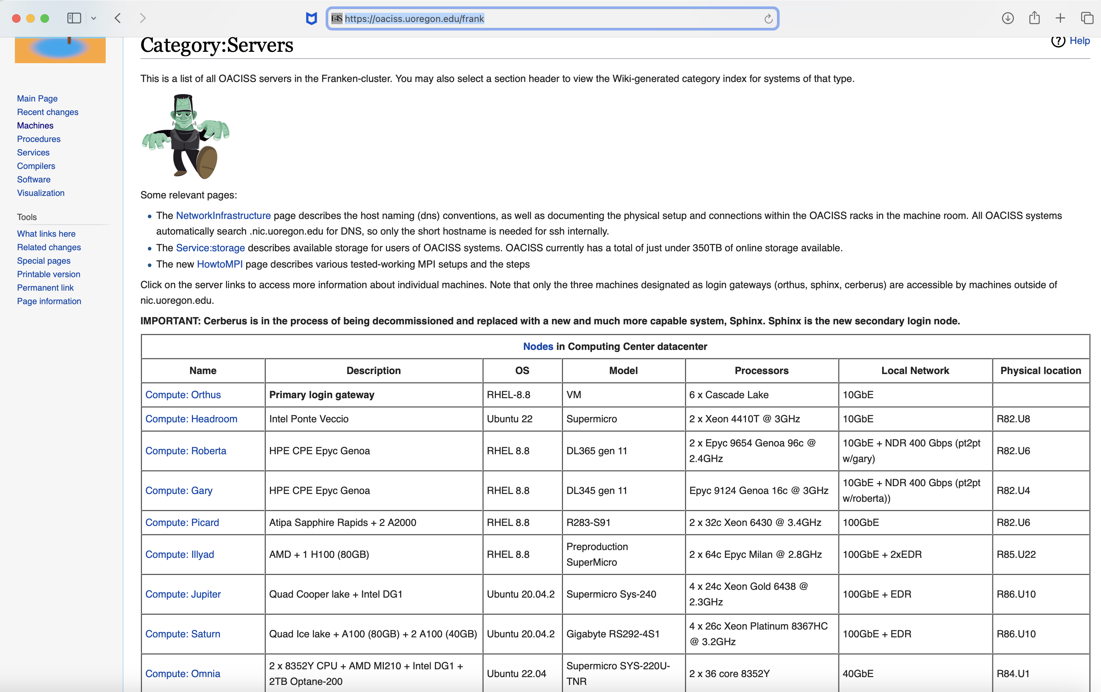
Frank: A platform for CI/CD at U. Oregon
https://oaciss.uoregon.edu/frank

Slide 10
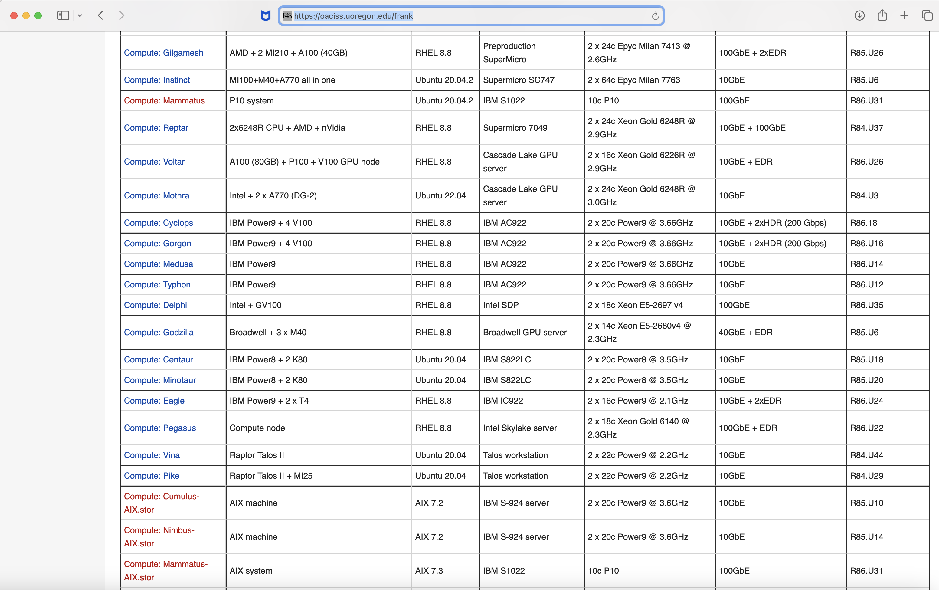
Frank: A platform for CI/CD at U. Oregon
https://oaciss.uoregon.edu/frank

Slide 11
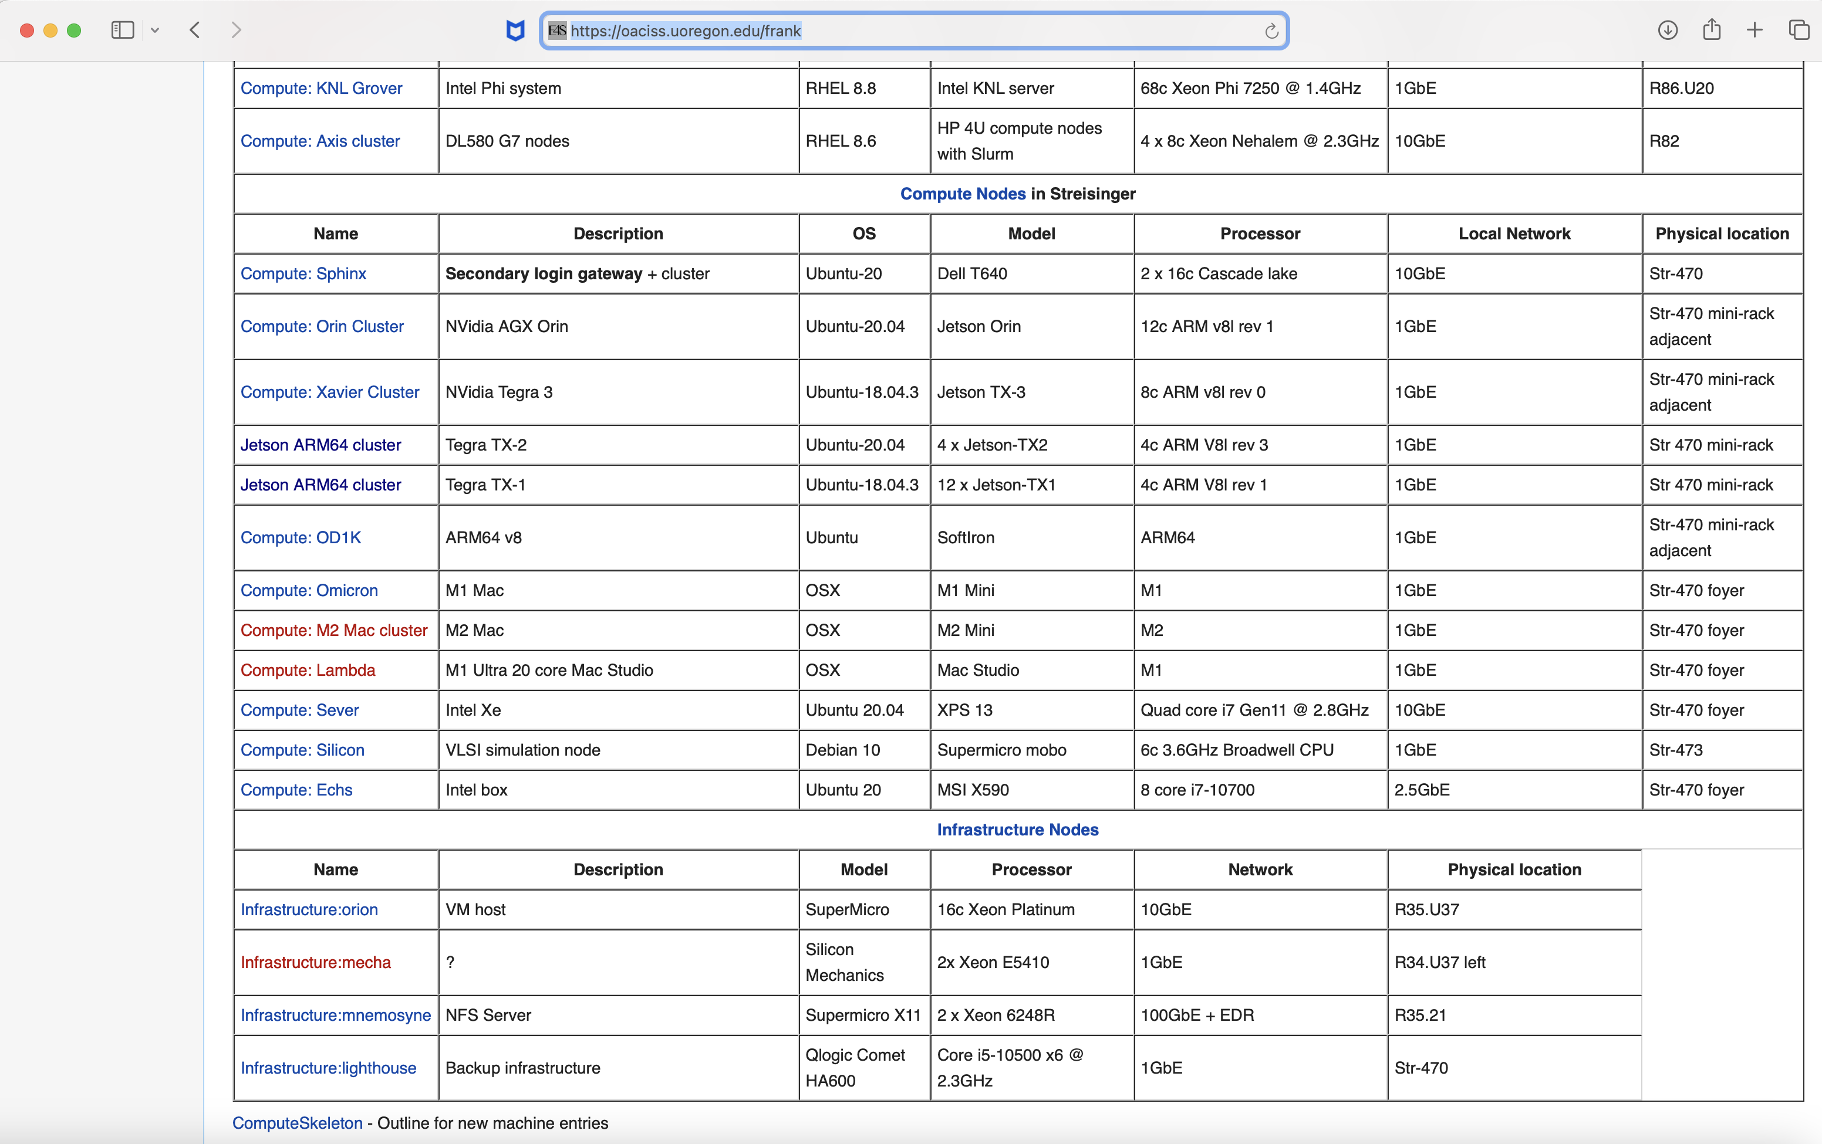
Frank: A platform for CI/CD at U. Oregon
https://oaciss.uoregon.edu/frank

Slide 12
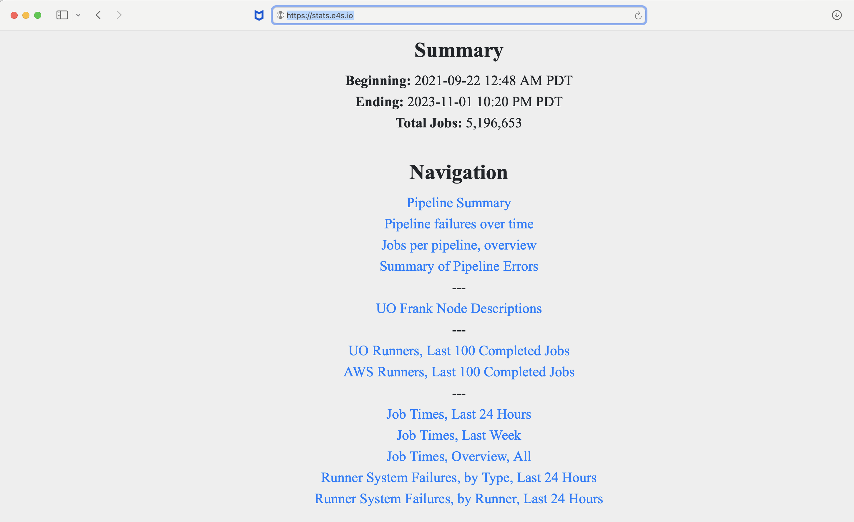
Spack PR Merge Jobs on Frank and AWS
Over 5M jobs!
https://stats.e4s.io

Slide 13
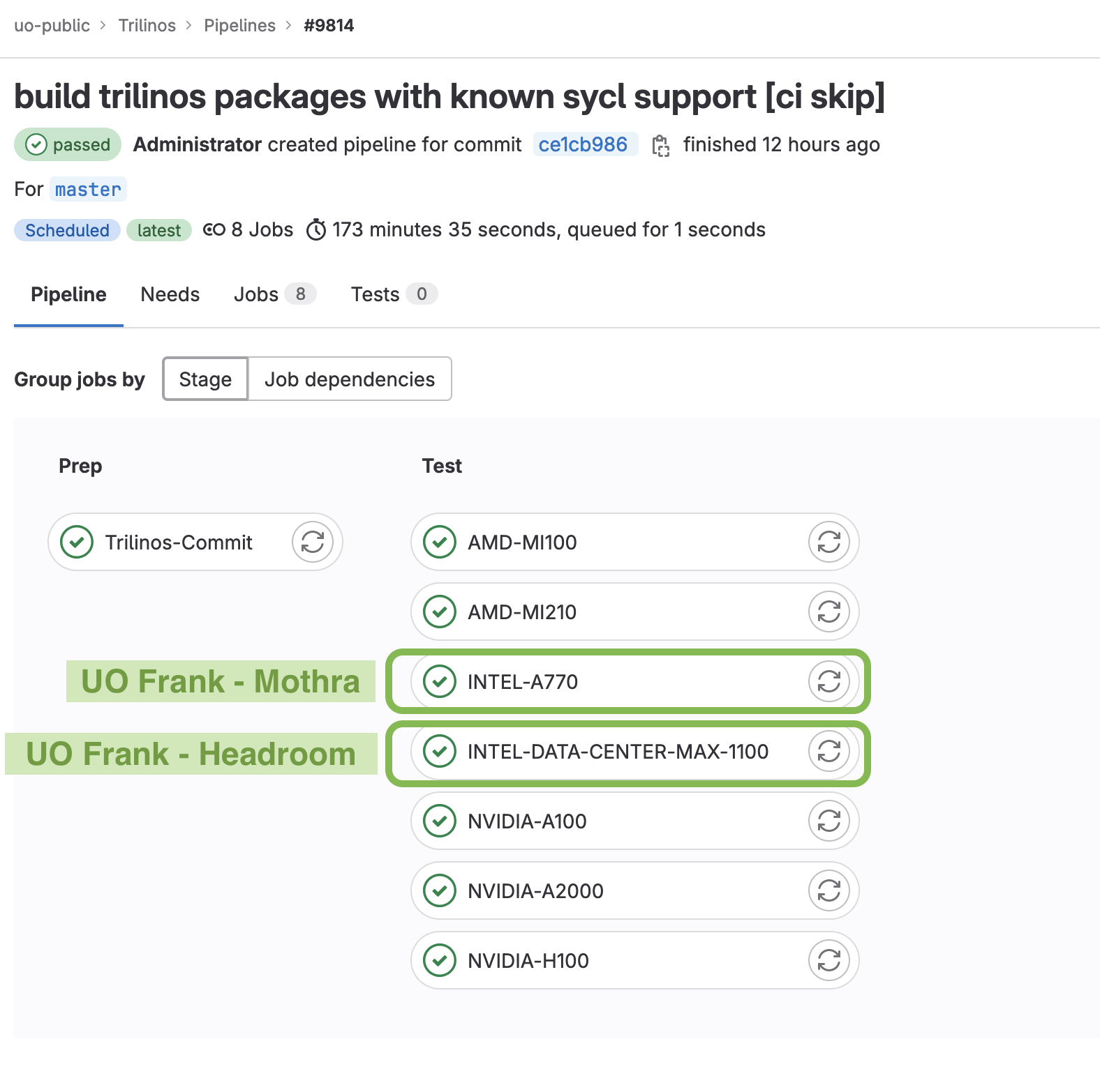
Trilinos: SYCL Enabled Builds Added to Nightly Testing
SYCL-enabled builds of Trilinos now tested nightly on:
Intel Data Center Max 1100 GPU (PVC)
Intel A770
Packages built:
Tpetra
Zoltan2
Ifpack2
Amesos2
Belos
Results from
October 30, 2023

Slide 14
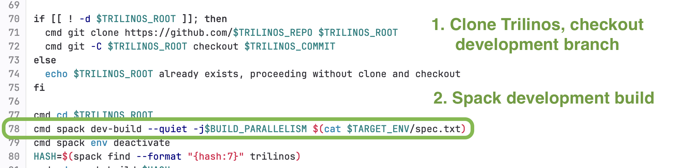
Spack Developer Workflow Integration
Trilinos development branch nightly builds now orchestrated using Spack developer workflow
https://spack-tutorial.readthedocs.io/en/lanl19/tutorial_developer_workflows.html
Script excerpt from https://gitlab.e4s.io/uo-public/trilinos/-/blob/master/ci.sh

Slide 15
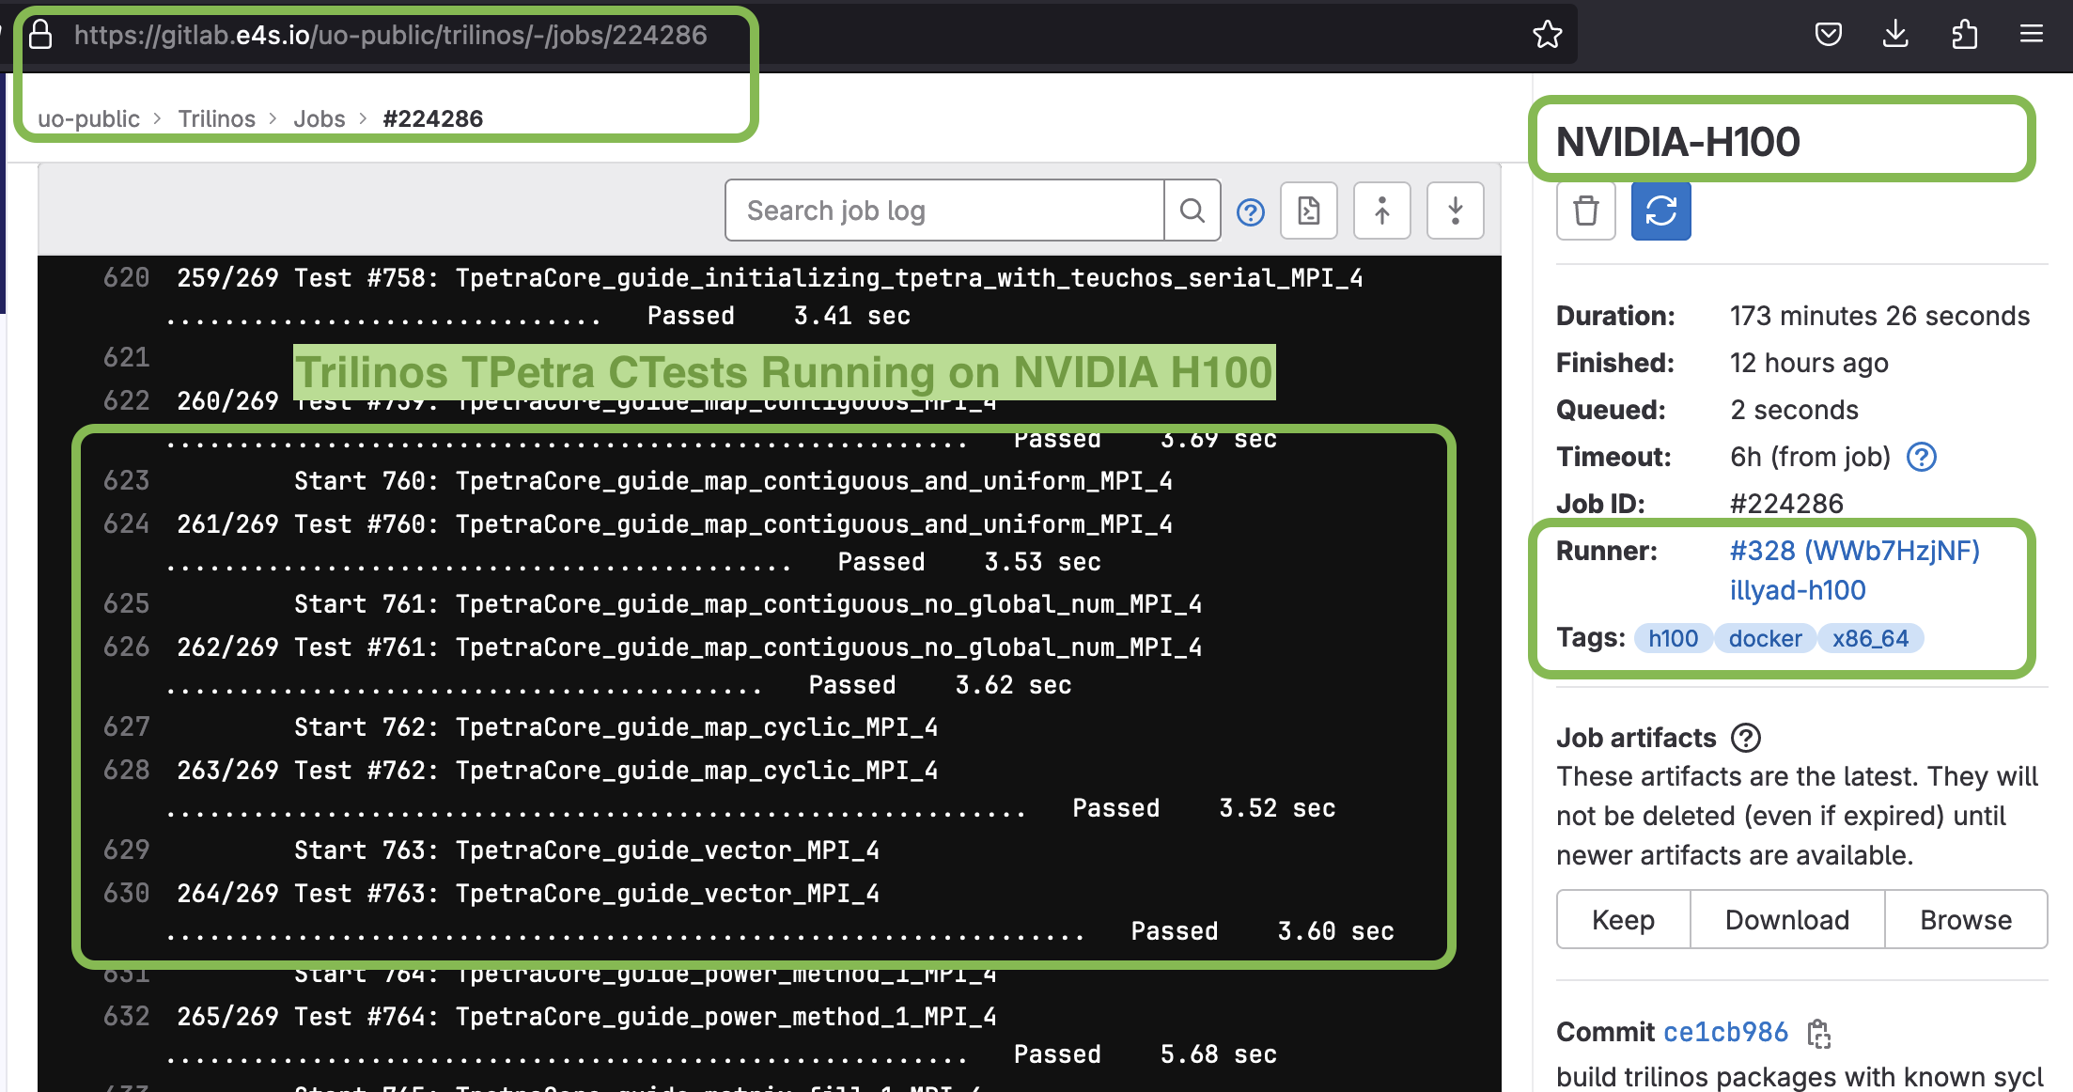
Trilinos Ctests Run Post-build

Slide 16
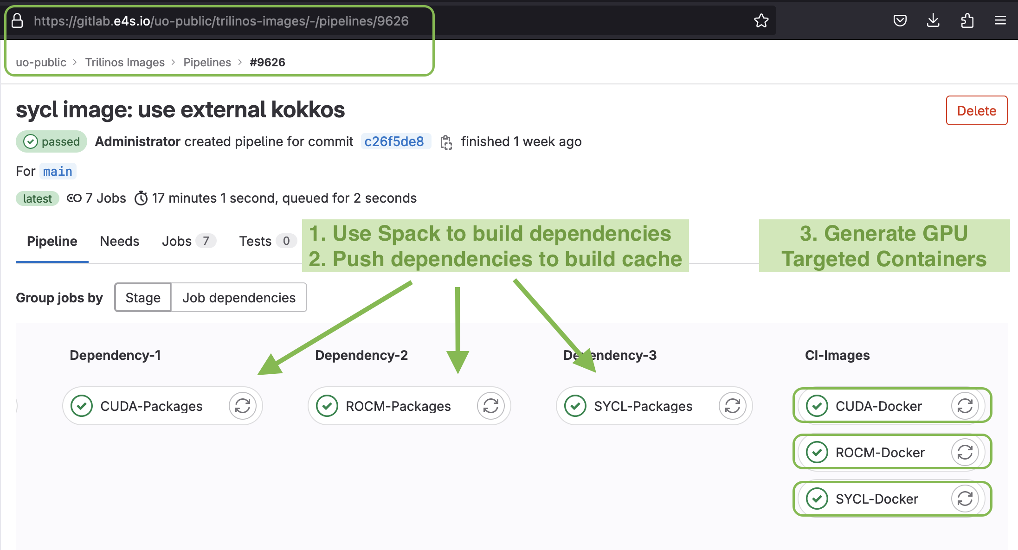
Automated CI Container Image Creation
https://gitlab.e4s.io/uo-public/trilinos-images

Slide 17
Automated CI Container Image Creation
Automated generation of CI container images makes it easier to:
Bring in changes from upstream Spack
Bring in latest versions of Trilinos’ dependencies
Use of Spack developer workflows means nightly build configurations tested closely mimic the builds that end-users would install themselves if they use Spack

Slide 18
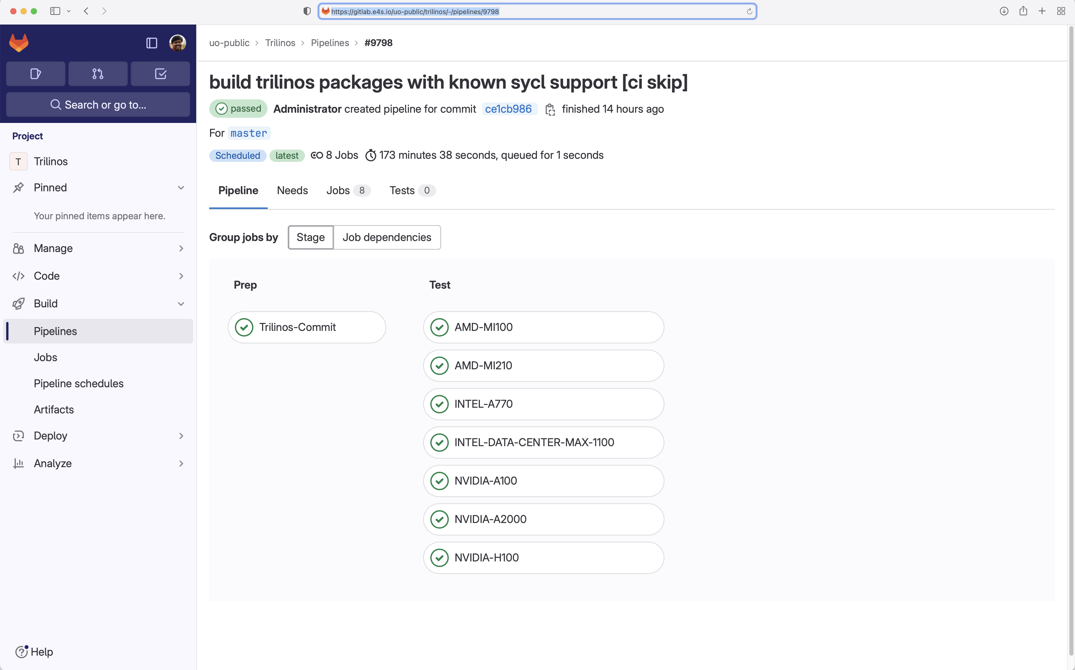
Trilinos nightly testing on 7 GPUs on Frank @ U. Oregon

Slide 19
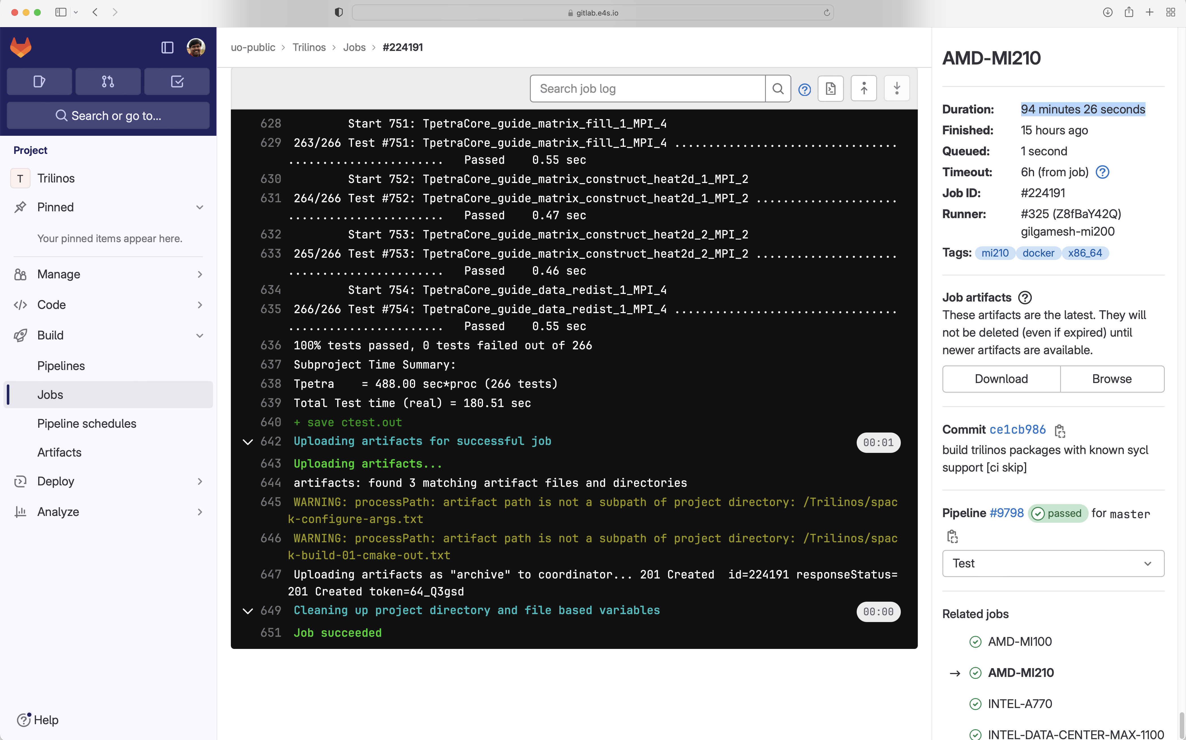
Trilinos Tpetra ctests nightly testing on AMD MI210 on Frank

Slide 20
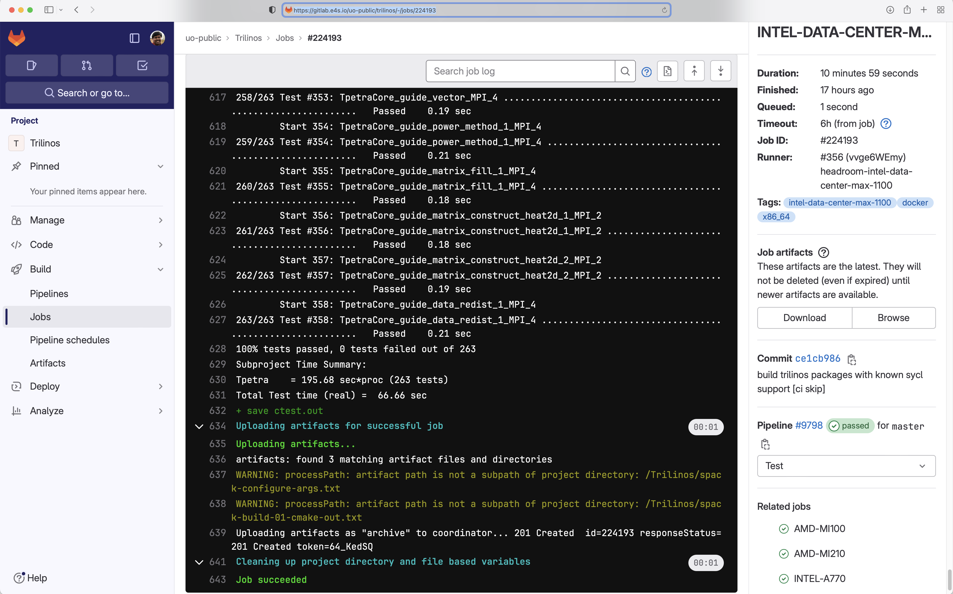
Trilinos nightly testing on Intel Data Center GPU Max 1100 (PVC)

Slide 21
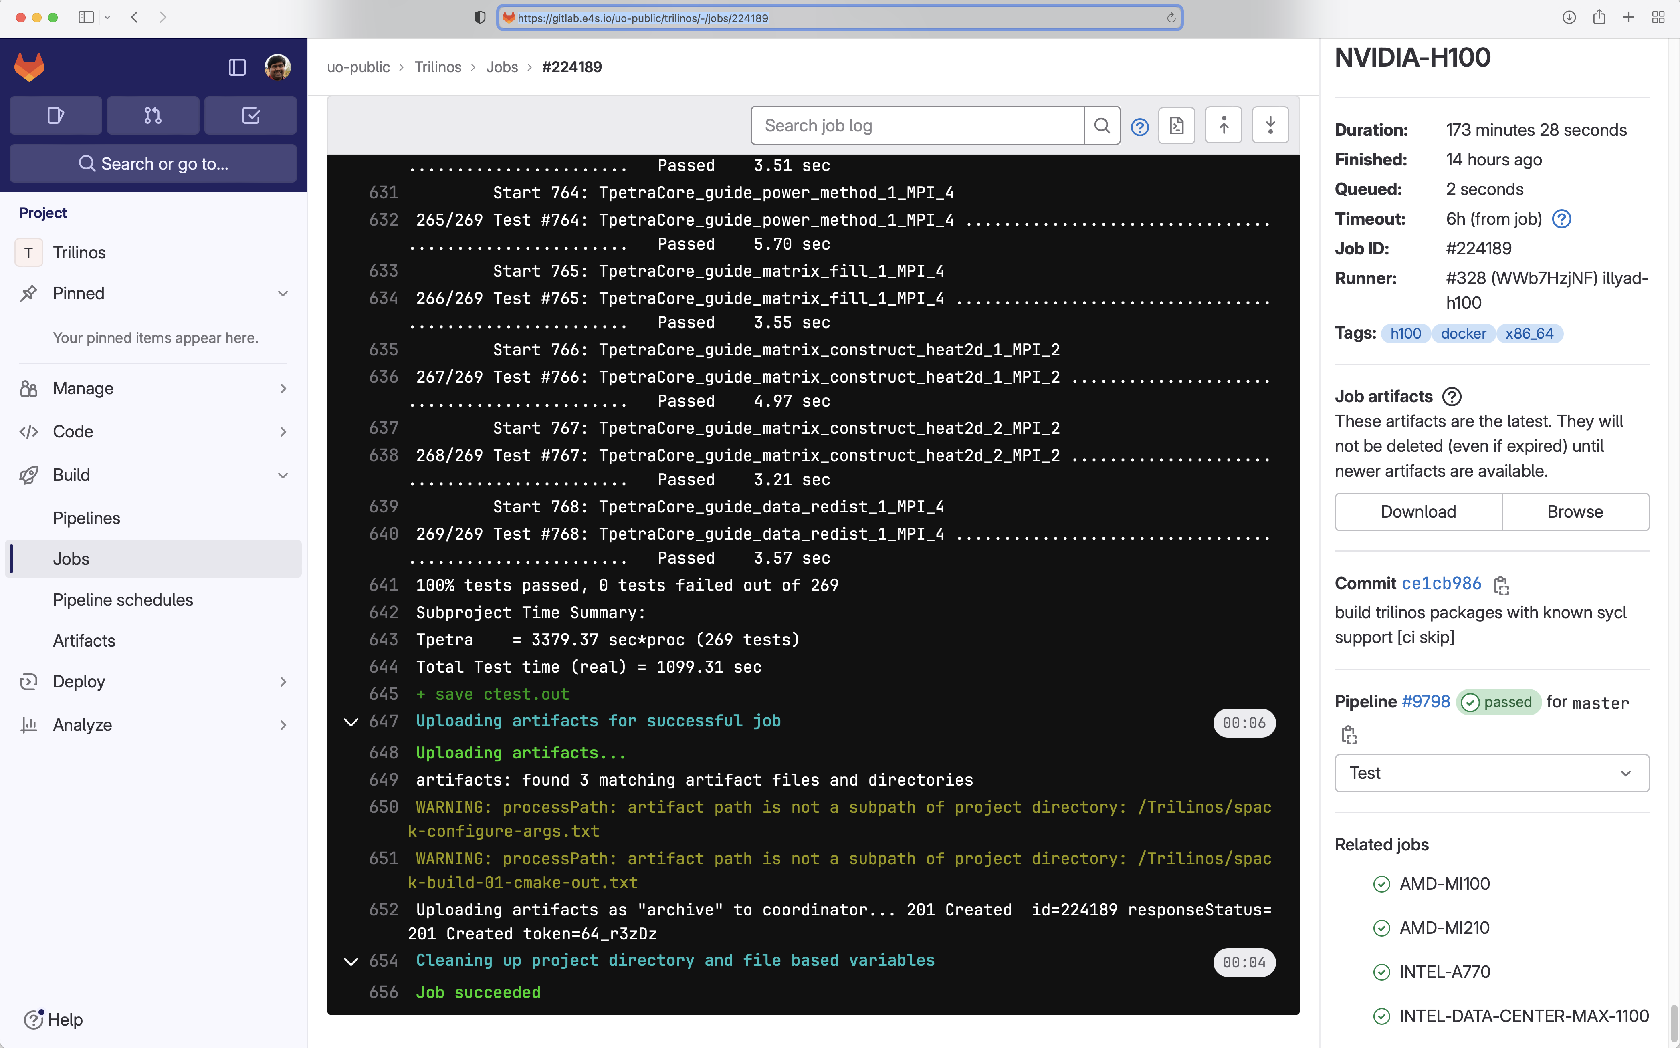
Trilinos nightly testing on NVIDIA H100 on Frank

Slide 22
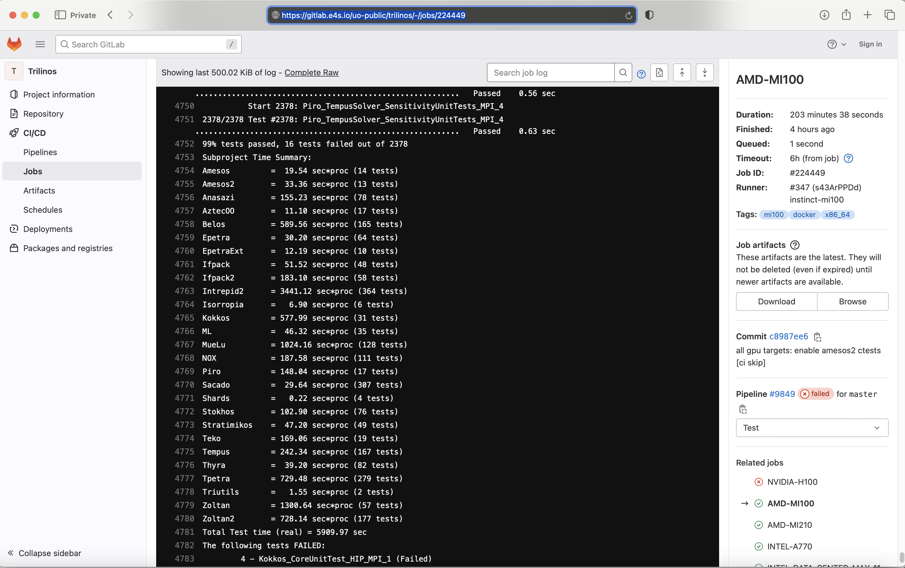
Triaging errors with expanded tests on AMD GPUs
2378 tests run
99% pass

Slide 23
SYCL Enabled Trilinos Issue #12420
When Trilinos is built with external SYCL-enabled Kokkos, the build works
When Trilinos is built with vendored SYCL-enabled Kokkos, the build fails
We are using External Kokkos for now
Trilinos SYCL build failing: llvm-foreach: Error: Device name missing. #12420
https://github.com/trilinos/Trilinos/issues/12420

Slide 24
Other Trilinos issues filed
Kokkos: Configure error with -DKokkos_ARCH_INTEL_XEHP=ON #12016
https://github.com/trilinos/Trilinos/issues/12016
ShyLU: ShyLU/ShyLUConfig.cmake:164 (include): could not find requested file: ../ShyLU_Node/ShyLU_NodeConfig.cmake #12048
https://github.com/trilinos/Trilinos/issues/12048

Slide 25
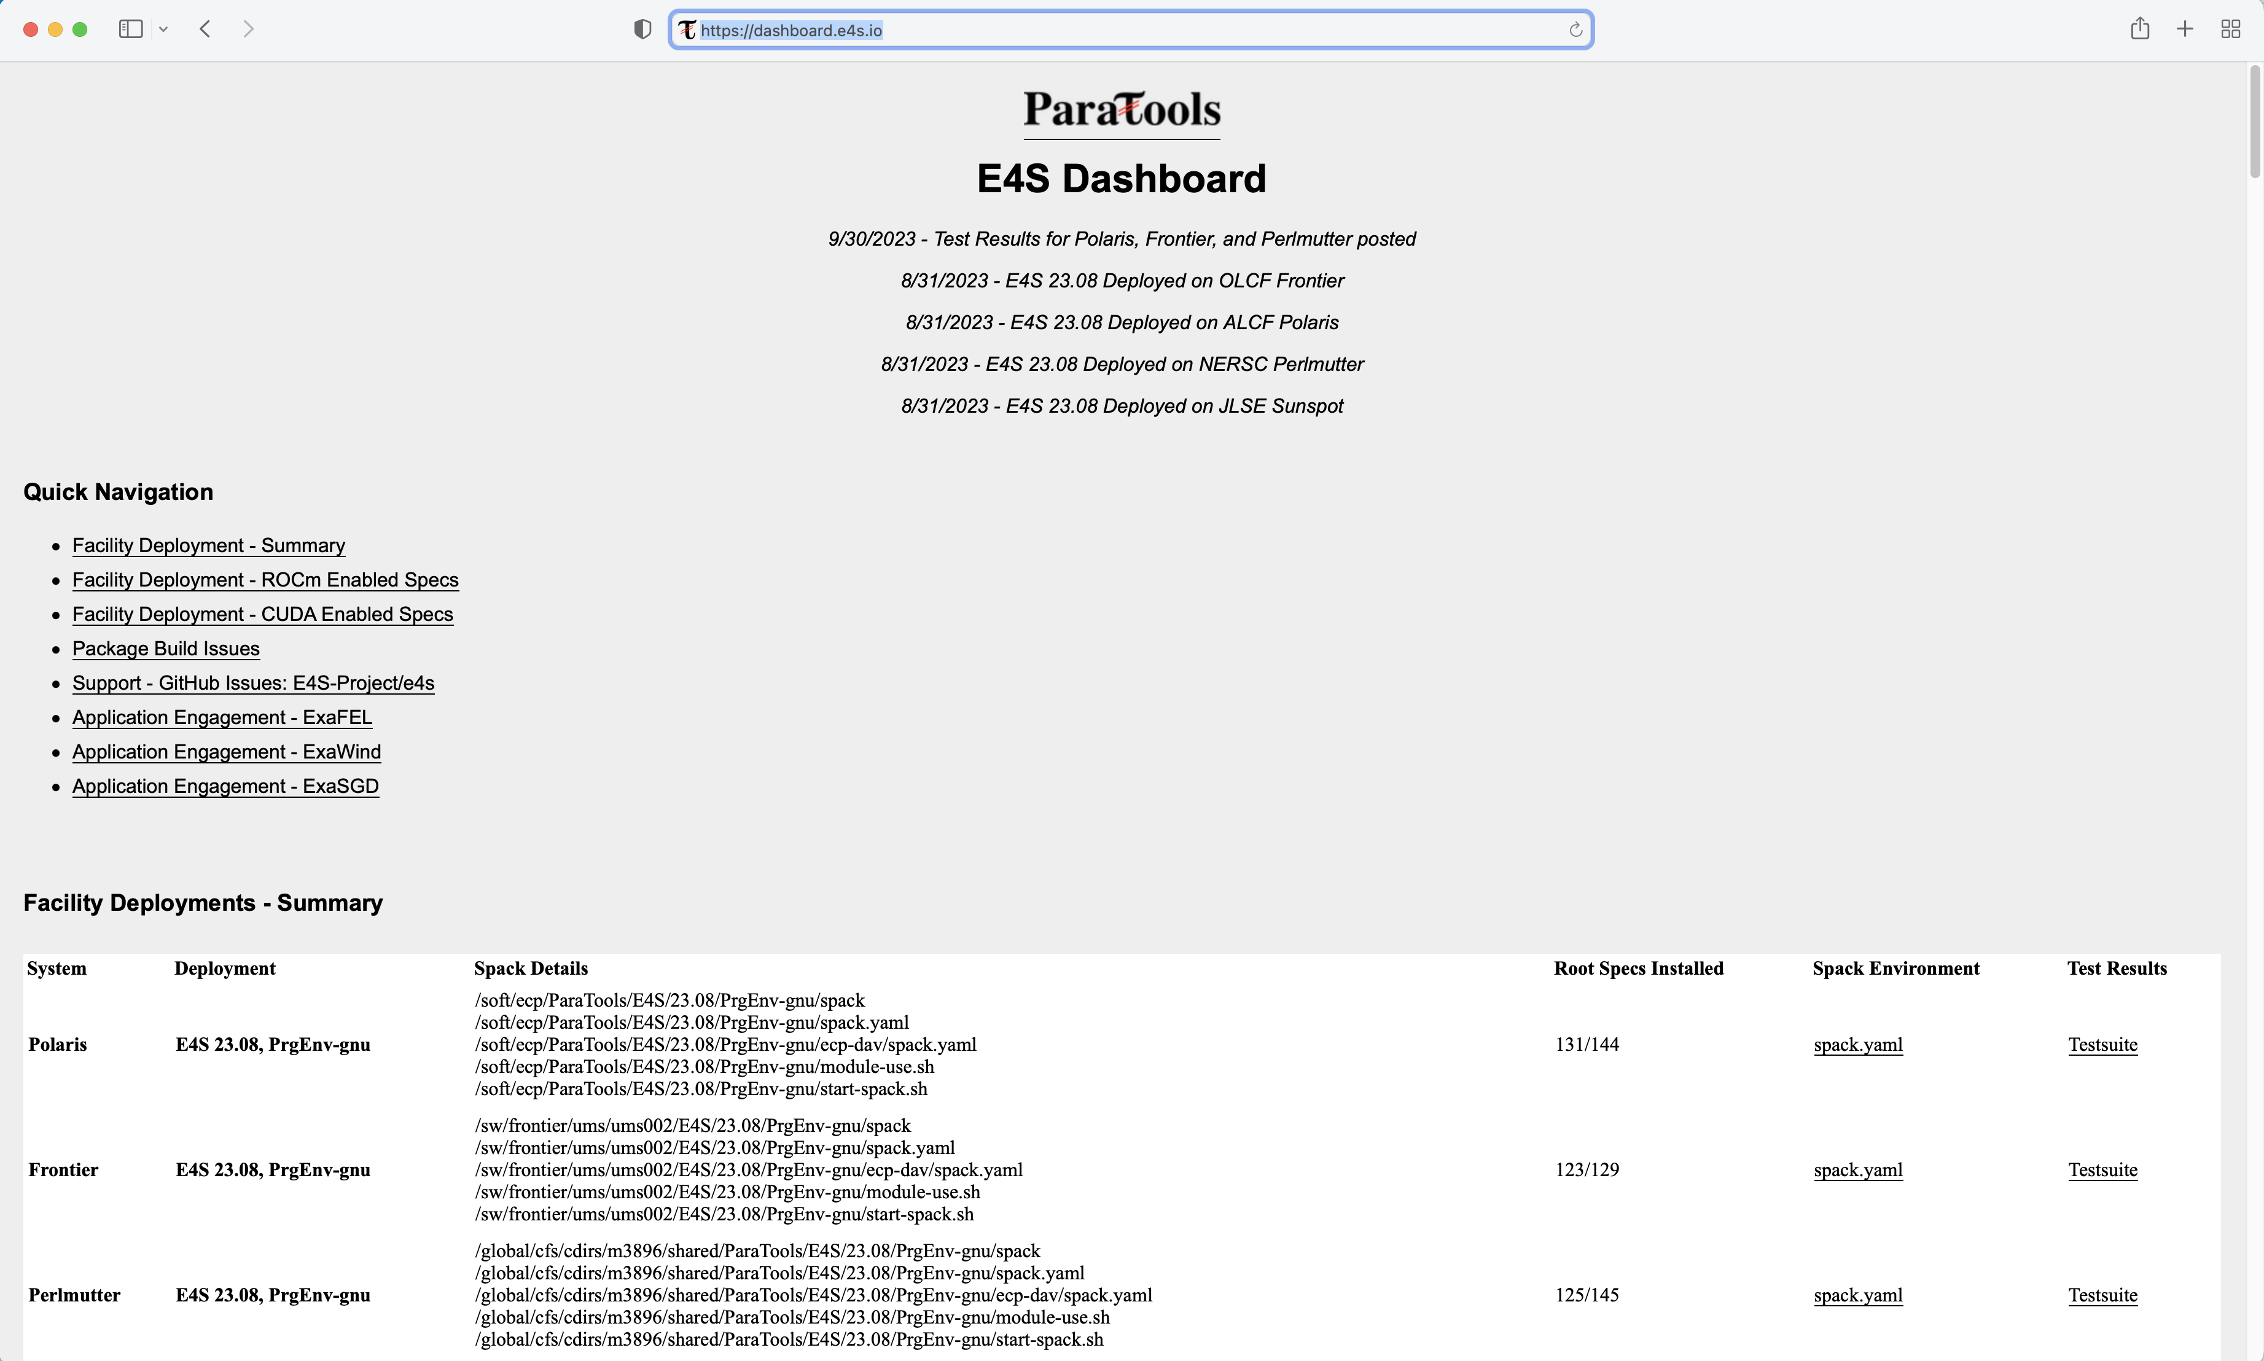
E4S installation Dashboard Progress: https://dashboard.e4s.io

Slide 26
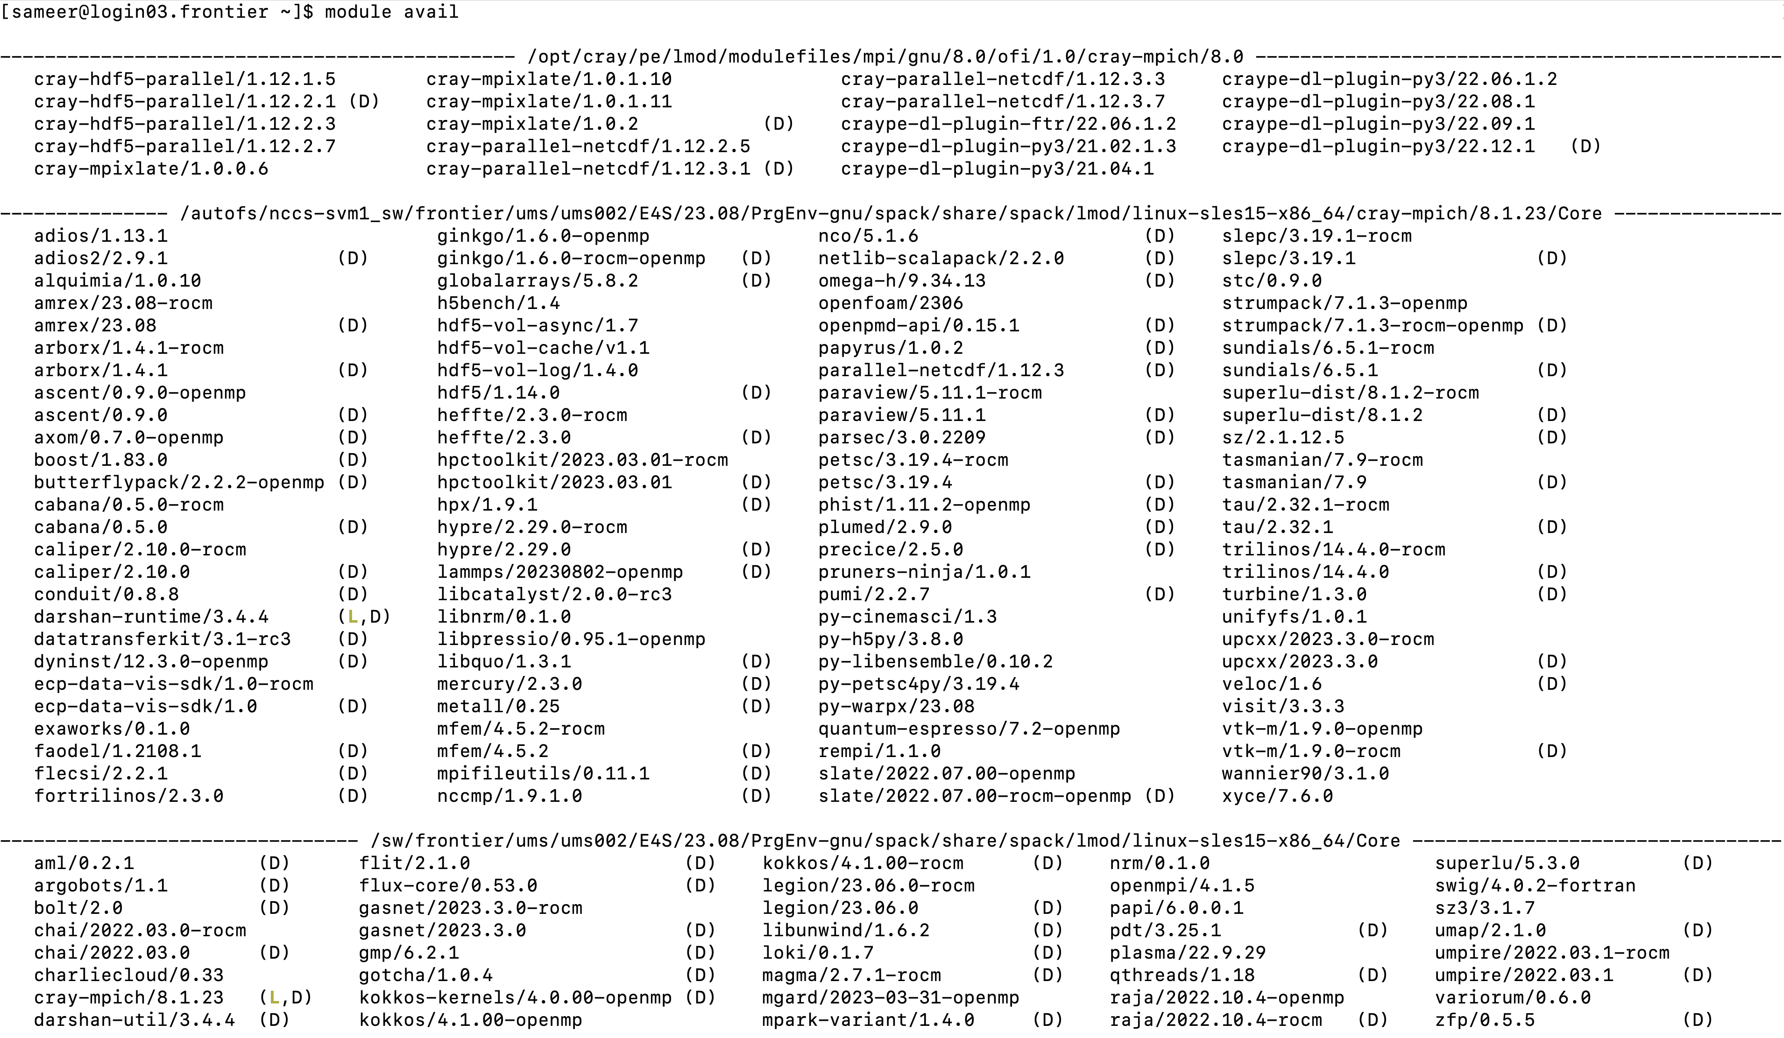
E4S 23.08 installation on Frontier at ORNL with Trilinos 14.4.0

Slide 27
E4S 23.08 installation on Frontier at ORNL with Trilinos 14.4.0

Slide 28
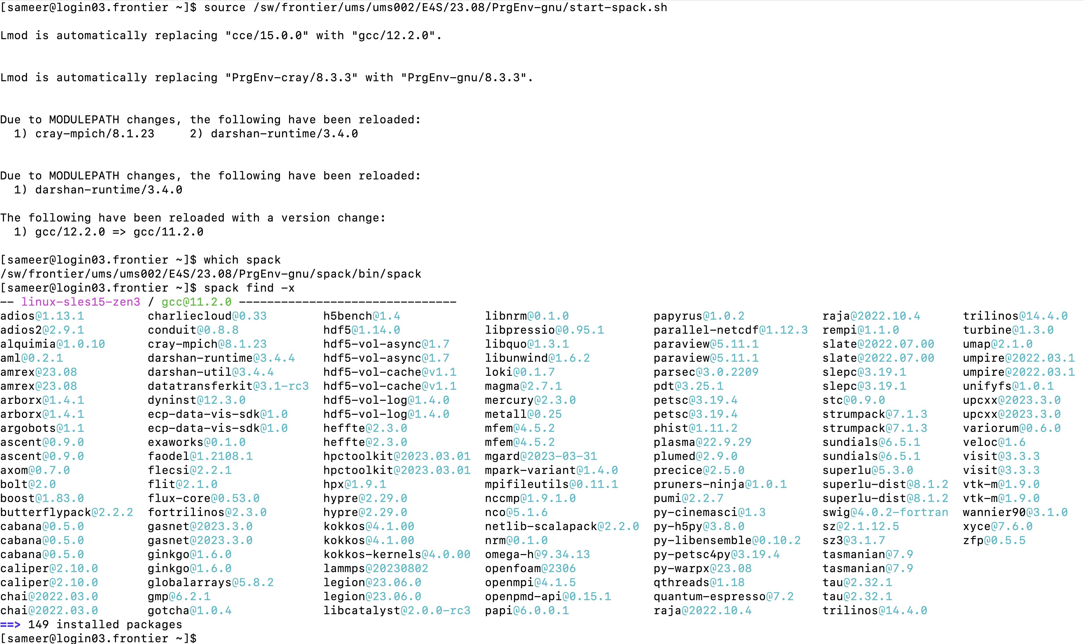
E4S 23.08 installation on Frontier at ORNL

Slide 29
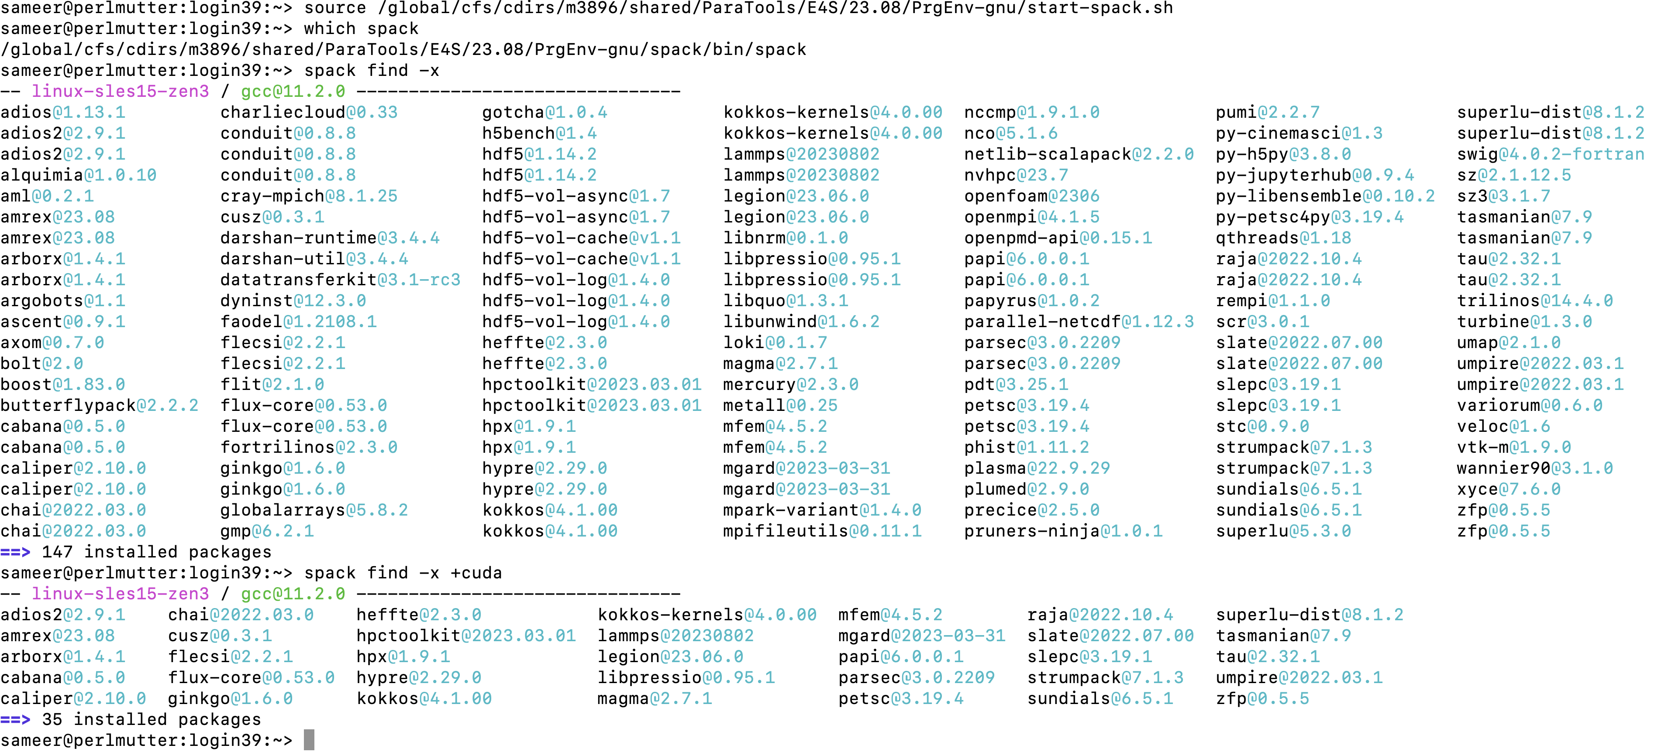
E4S 23.08 installation on Perlmutter at NERSC

Slide 30
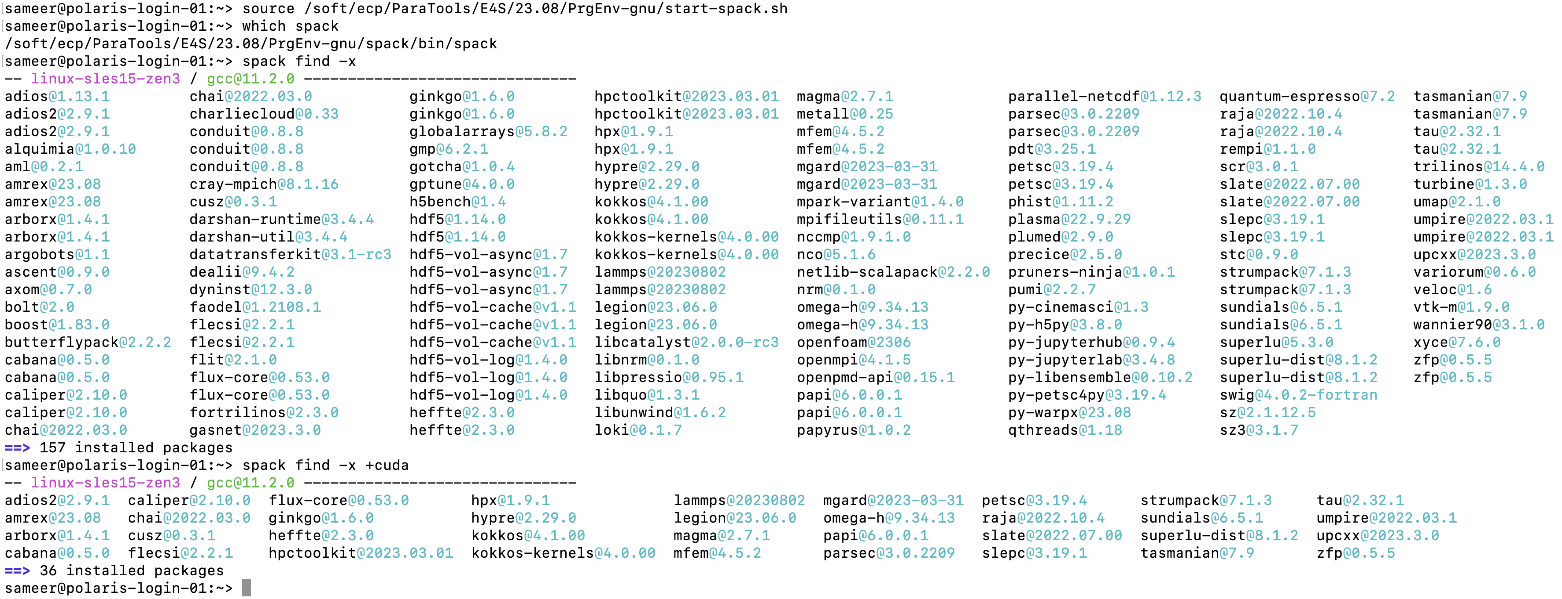
E4S 23.08 installation on Polaris at ALCF

Slide 31
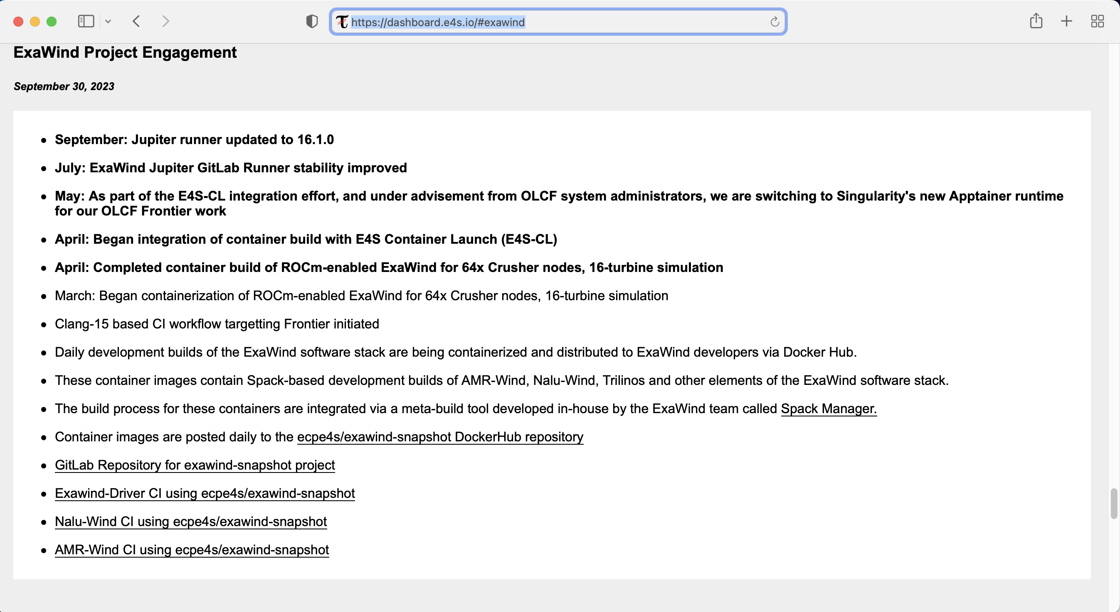
Progress Report of E4S Support for ExaWind by ParaTools, Inc.

Slide 32
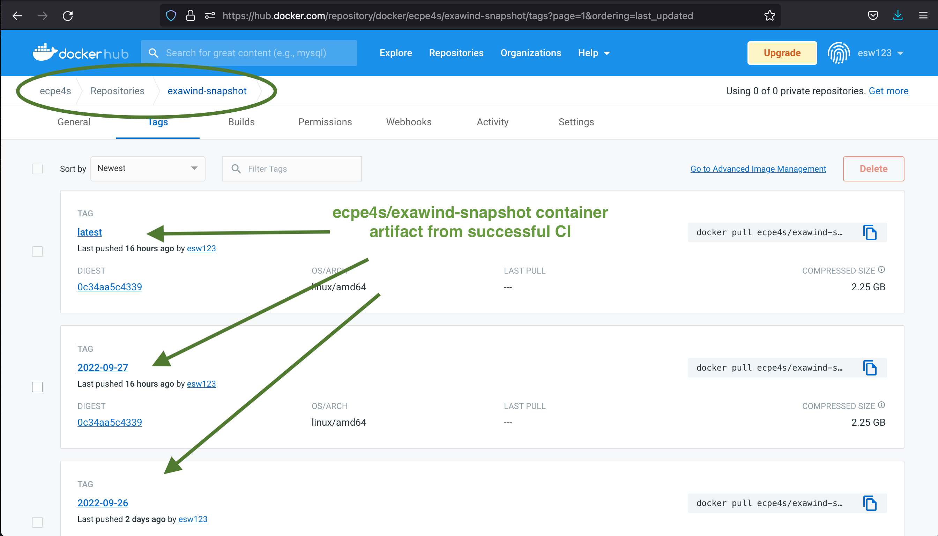
ExaWind CI: Container Image Artifacts on DockerHub
https://hub.docker.com/repository/docker/ecpe4s/exawind-snapshot/tags?page=1&ordering=last_updated

Slide 33
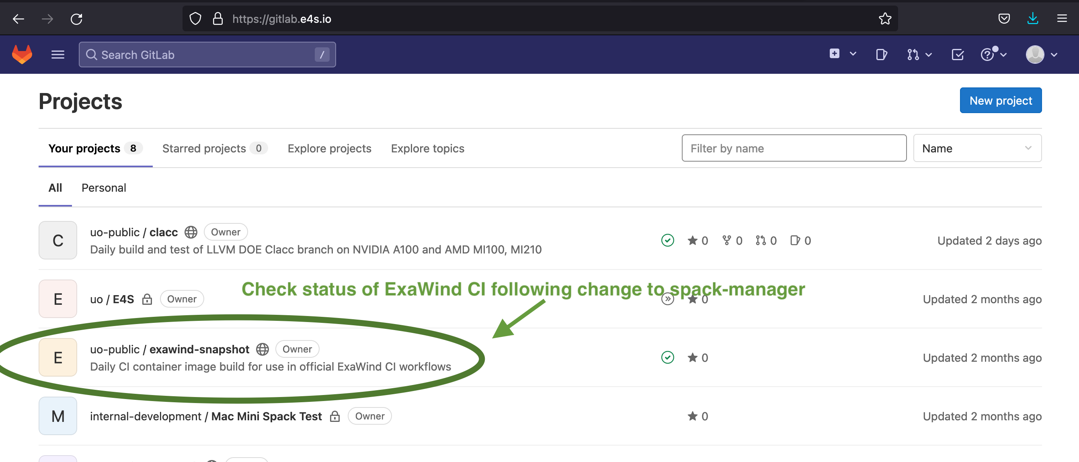
ExaWind CI: Exawind-Snapshot Project on gitlab.e4s.io
https://gitlab.e4s.io/uo-public/exawind-snapshot/-/pipelines

Slide 34
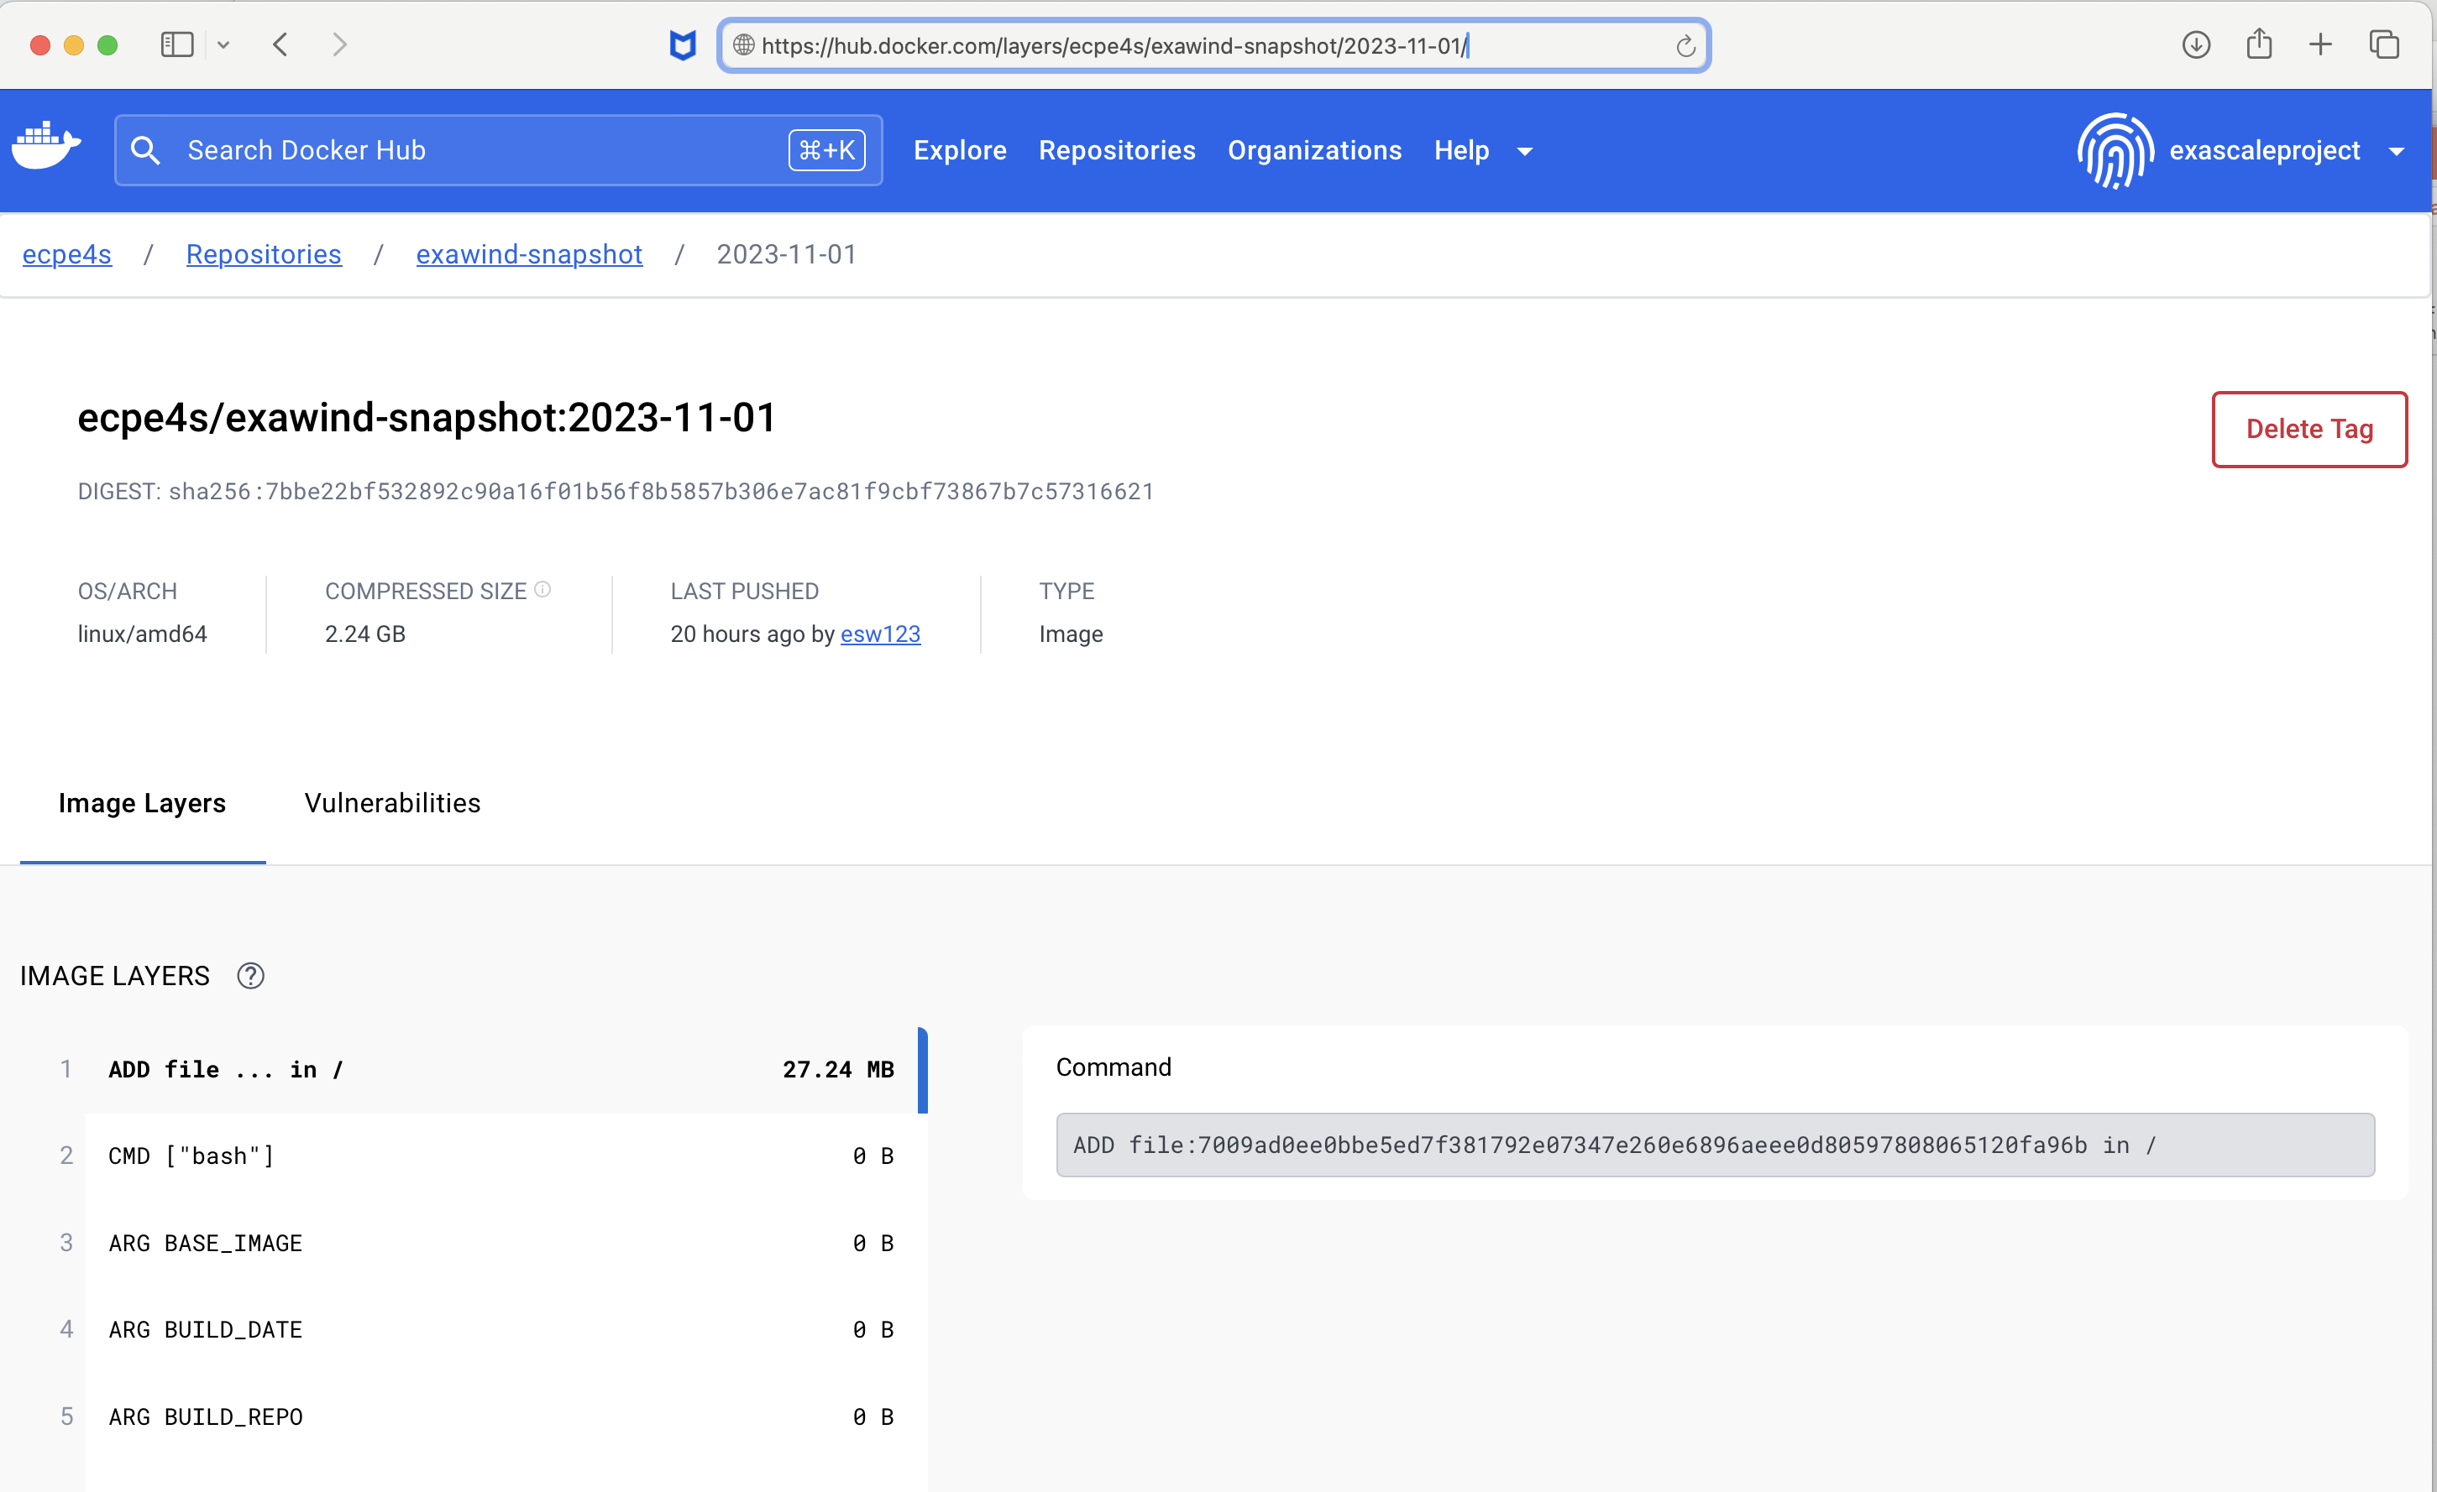
Exawind daily snapshot at DockerHub
2023-11-01

Slide 35
ExaWind CI: Container Image Artifacts on DockerHub
https://hub.docker.com/repository/docker/ecpe4s/exawind-snapshot/tags?page=1&ordering=last_updated

Slide 36
Thank you
https://www.exascaleproject.org
This research was supported by the Exascale Computing Project (17-SC-20-SC), a joint project of the U.S. Department of Energy’s Office of Science and National Nuclear Security Administration, responsible for delivering a capable exascale ecosystem, including software, applications, and hardware technology, to support the nation’s exascale computing imperative.
Thank you to all collaborators in the ECP and broader computational science communities. The work discussed in this presentation represents creative contributions of many people who are passionately working toward next-generation computational science.

Slide 37


